Slide 1
Protein Dataset : Protein-Protein Interaction in Yeast.
Nodes : Protein
Edges : Interaction
Kinshuk Dwivedi : 19174012 ; Engineering Physics
Vedang Kshirsagar : 19174013; Engineering Physics
S V Yuva Kishore Reddy : 19064015; Civil Engineering
Vikhyat Dwivedi : 19064019; Civil Engineering

Slide 2
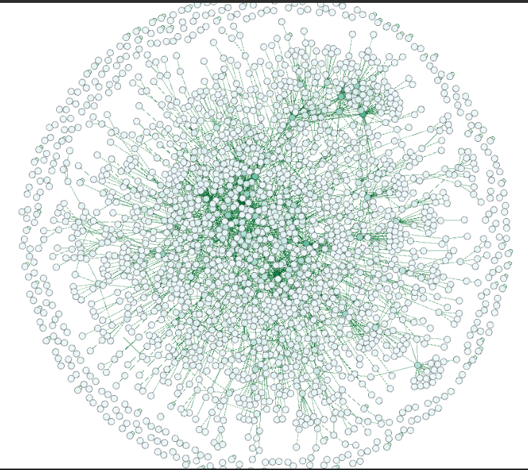
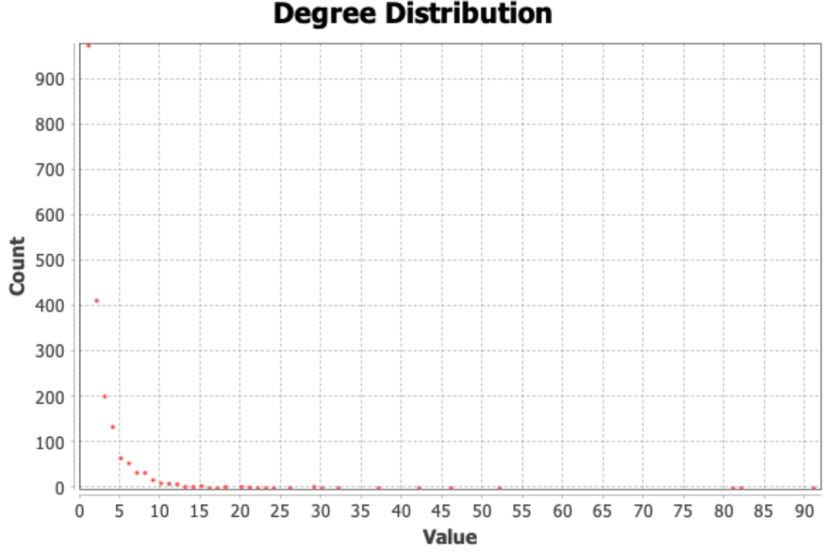
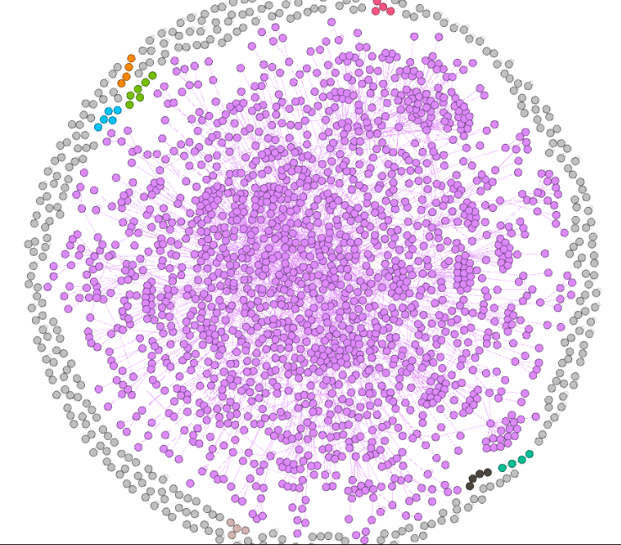
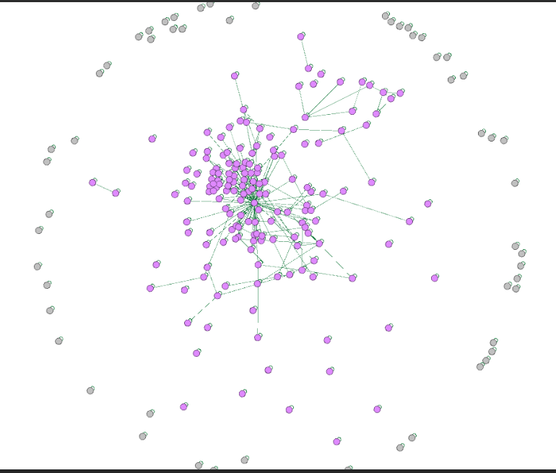
Network Topology
Total Nodes: 2018, Total Edges: 2930
Sparse graph; as Lmax (~ 2 X 10^5) >> L
Average path length : 5.61
Network Diameter : 14
Graph Density : 0.001
Min Degree: 0 (isolated); Max Degree: 92 (hub)
Fig1.1 Average Degree : 2.903
Fig1.2 Connected Components : 185
Fig1.2 Nodes having Self loop; Undirected and Unweighted Edges

Slide 3
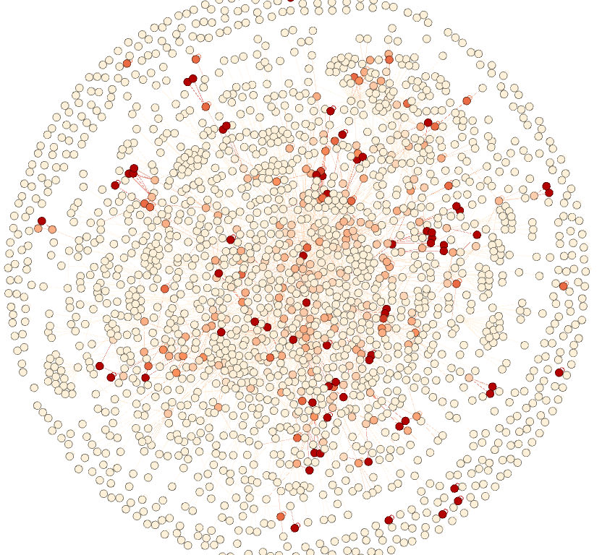
Network topology
Average Clustering Coefficient: 0.134
Average Degree: 2.903
Connected Components: 185
Communities: 208
Observation:
The described graph exhibits:
Moderate local clustering.
Less nodes with high degree and many nodes with low degree having a skewed distribution.
Tail in power degree distribution
Therefore our network is “SCALE FREE NETWORK”
Fig3 Nodes that have more dense color are node with high clustering coefficient.

Slide 4
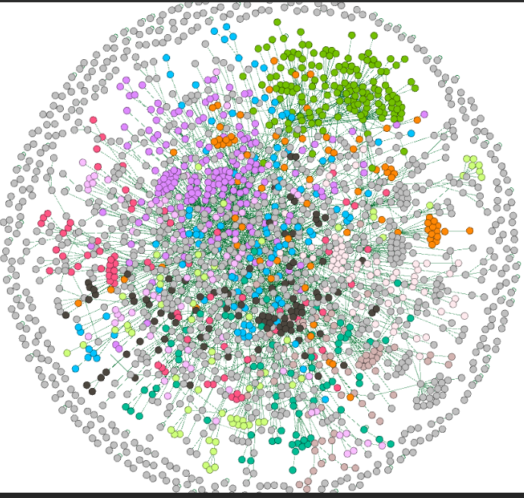
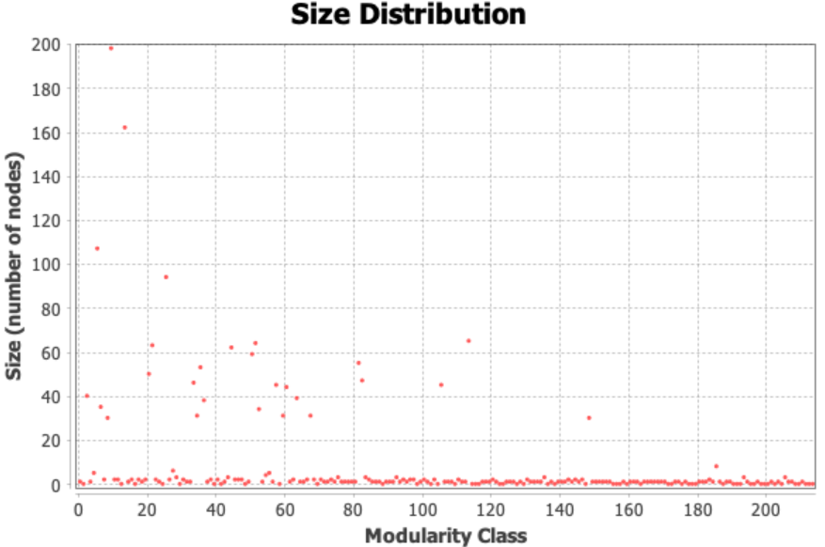
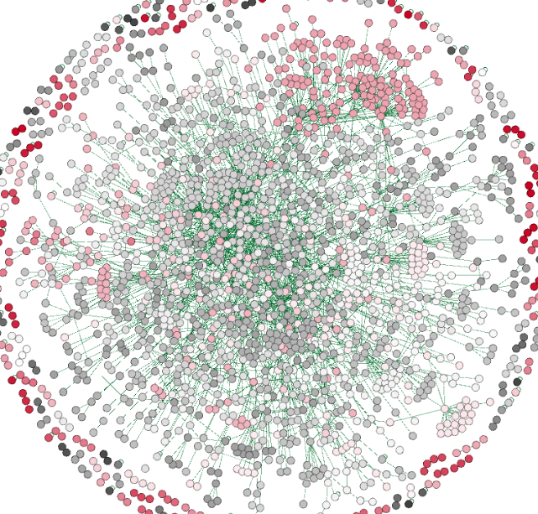
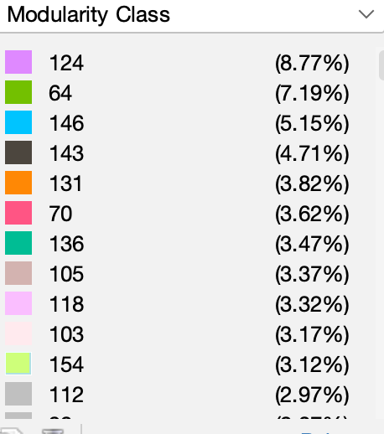
Network Structure, Community Analysis
Fig2. Total no of communities: 208
Modularity: 0.753

Slide 5
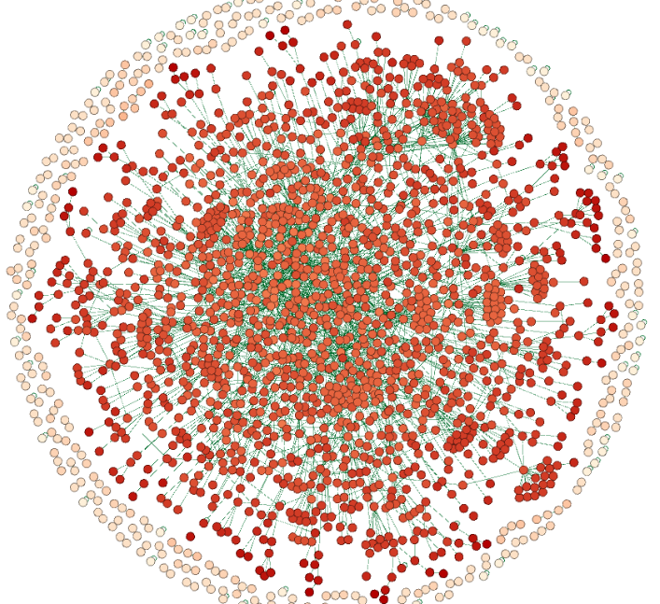
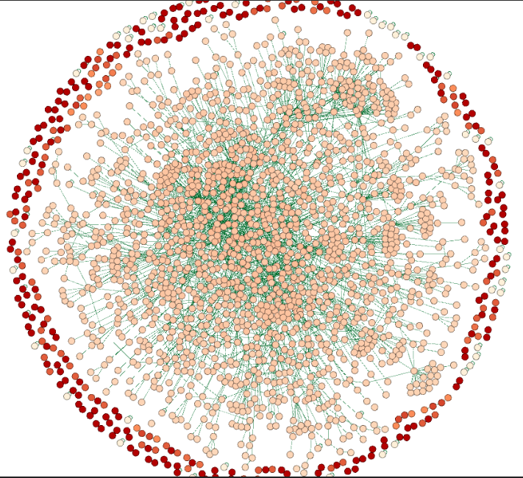
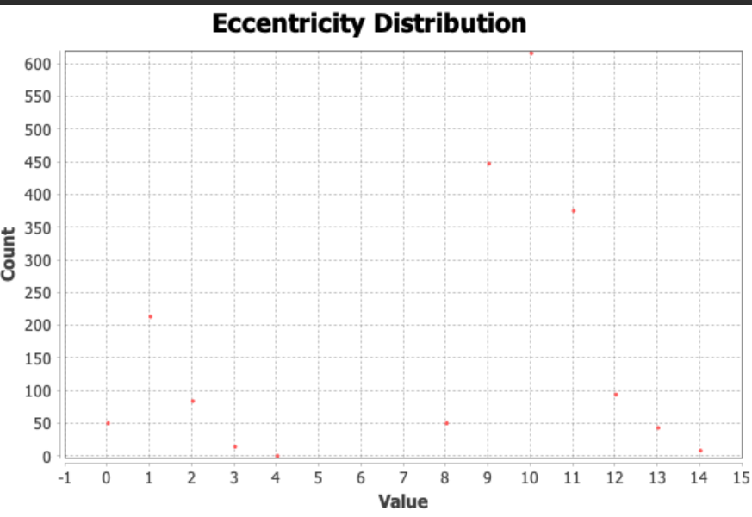
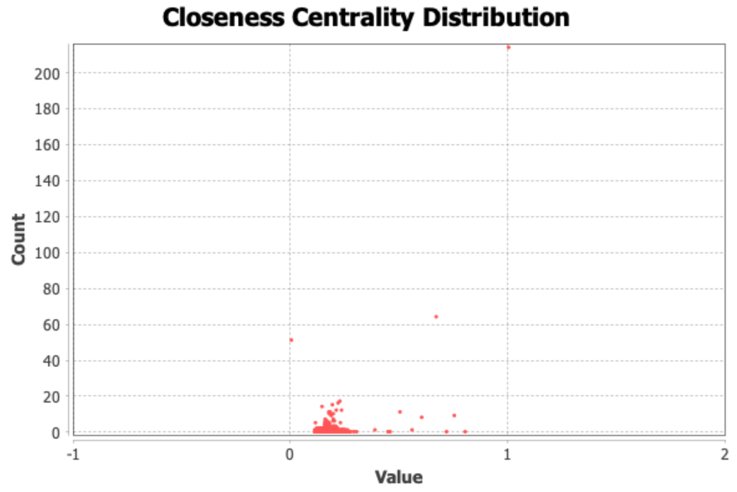
Eccentricity
Closeness
These metrics help in understanding the communities in the network, reachability of a node i.e., its importance and the network’s paths lengths and diameter.
Here, closeness distribution is rightly skewed indicating that multiple nodes are far away from each other and a very few of them are close enough.
Here eccentricity distribution represents that a very few nodes are close to the remote ones and most of them are far from them as well as each other.

Slide 6
Work Distribution
Thank you
Kinshuk Dwivedi (19174012) : Network Topology, Network Structure, Gephi Tool
Vedang Kshirsagar (19174013) : Community Analysis, Analysis of Network type
S V Yuva Kishore Reddy(19064015): Closeness , Eccentricity
Vikhyat Dwivedi (19064019): Degree Analysis, Clustering Analysis, Presentation Creation and compiling all data.

